Slide 1
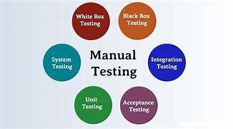

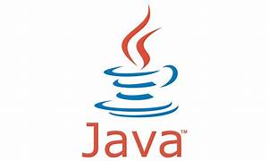
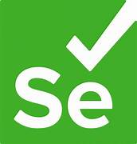

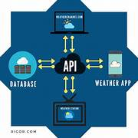



Advanced Software Testing

Slide 2
Software Testing
Manual Testing
Introduction
Software and its Types
Principles of Software Testing
Types of Testing
Levels of Testing
Test Methods
QA vs QC
Software and its Types
Principles of Software Testing
Types of Testing
Levels of Testing
Test Methods
QA vs QC
SDLC And STLC Models
STLC
Defect Life Cycle
Test Plan
Use Case
Automation testing Introduction Java Selenium Using WebDriver FrameWorks JDBC TestNG BDD Cucumber Maven

Slide 3
MySQL: stands for Structed Query Language, By executing queries SQL can create, update, delete, and retrieve data in databases like MySQL, Oracle, PostgreSQL, etc. Overall SQL is a query language that communicates with databases
DDL
Introduction SQL Statements Operators Data Types Basic Queries Aggregate Functions Single Row Functions Constraints and Rules SubQuery Clauses Joins
DML
DRL/DQL
DCL
TCL

Slide 4
JAVA: i) It is a high level Programming Language ii) Object Oriented Programming Language iii) It is a Platform independent
Introduction Data Types Variables Operators Scanner Class JVM, JRE, JDK Conditional Statements Loops Arrays Strings Class and Objects OOPS Concepts

Slide 5
FrameWorks
Behaviour Driven Development(BDD)
DataDriven
Hybrid
KeyWordDriven
Test Driven Development(TDD)

Slide 6
JMeter Load Testing is a testing process done using a load testing tool named Apache JMeter which is open source desktop application based on Java. JMeter for load testing is a crucial tool that determines whether the web application under test can satisfy high load requirements or not. It also helps to analyse overall server under heavy load.
JMeter
Http Request
Thread Count
Samplers
Listeners
Logic Controller
View Results Tree
Test Script Recorder
Recording Controller
Test Script Recorder
Multiple Tabs
Assertions
Response Code

Slide 7
Selenium is a free (open source) automated testing suite for web applications across different browsers and platforms.
Selenium Automation
WebDriver
WebPage Automation
Method Names
Locators
Syntax
Drop-Down
ScreenShots
Alerts
Drag and Drop
Page Factory
Maven
JDBC
Frameworks

Slide 8
thank you
M.Bhaskar Rao meda.bhaskarrao@gmail.com

